Slide 1
Apple Grower’s Plugin UI & UX
Conceived & Conceptualized by
Dev Bhardwaj
Daksh AI, ML & IOT Technologies India

Slide 2
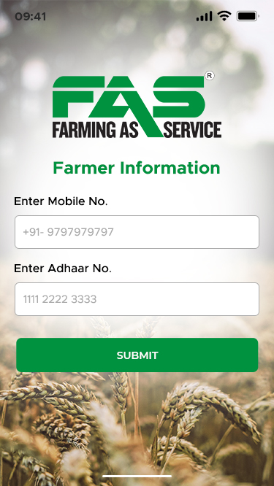
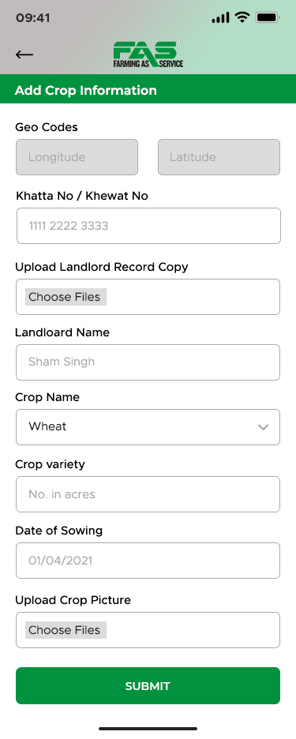
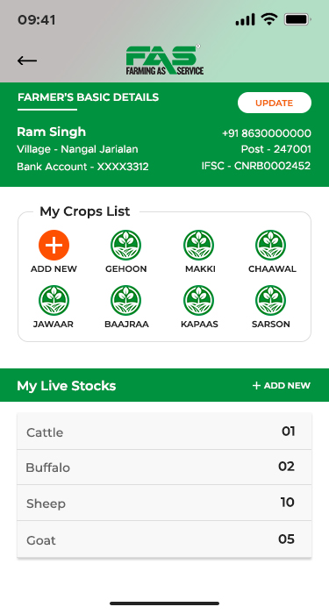

Add your Orchards
Grower’s Dashboard
Orchards Name
Total Fruiting Trees
UI-1 Grower Sign up
Expected Date of Harvesting
My Orchards
Orchards Location
Orchard-1
Orchard-2
Orchard-3
Your Commission Agent
Orchard-4
Orchard-5
Orchard-5
Orchard-7
Your Commission Agent Cell No
APMC Name /Company Name
My Orchards
Date of Harvesting
Fruiting Trees
Expected Boxes-25
Orchard-1
DOH
150
150
Orchard-2
DOH
110
110
Do you have your own PackHouse
Orchard-3
DOH
250
250
Orchard-4
DOH
135
135
Nearest Pack House Name
Orchard-5
DOH
2200
2200
Orchard-5
DOH
1560
1560
Nearest Pack House Cell No
Orchard-7
DOH
750
750

Slide 3
Grower’s will sign up using their Adhar No. We have Approx 9 lakh growers data base with Adhar linked cell no which wee will pre load in our application. Once they Enter their Adhar No. our system shall capture the address details including PIN no to save for those who are not registered/ pre uploaded in our database.
Next Screen shall come to add Grower’s orchards. Every Location have their names. No. of fruiting trees will help us understand total production and Expected Date of Harvesting will help our system to forecast expected no. of vehicles required on daily weekly and monthly basis and regions wise. For saving the orchards location we will use GPS map location which will navigate to his currant location and our screen shall show a prompt to him to find his orchards and mark his orchards boundaries. Field Area Search Apps help us to calculate total area the grower has marked. Once the orchard has been marked with free marker tool, an image png will be saved with orchards profile of the location marked. Grower will submit the profile of his orchard.
Note: A Grower will have multiple orchards and multiple locations and maximum of 7 location will be provided by our system. In case of more than 7 location our system shall prompt grower to add the more location under another user name. Add new button will clear the data input and prompt for new orchards addition. Once all orchards submitted one by one , Farmers sell their produce to multiple commission agents or corporate companies as well depending upon price. This will help us aggregating date of commission agents and corporate companies buying from farmer and will get saved in data bank to acquire data base. Grower will update Packing House Status if he has his own pack house or he get its services from other packing houses. This will help us generating packing houses and will get saved in Packing houses data base. Once added this information He will update his commission agents / Aadhati details name, cell no and APMC mandi where he sells his farm produce.
We need a AI supporting navigator to every user to guide through our application.
3rd screen will create a Grower's Dashboard what he has input and will have right to edit his information and will count No. of orchards and total no of trees which will help our system to analyse when and where No. of vehicles are required. Our Social media marketing campaign to enrol vehicle and their placements as per locations will be placed. Date of Harvesting shall be always editable as lot of factors decide it- market demand and price , availability of harvesting labour, Availability at packhouse or packing labours , availability of harvesting crates, whether etc. so our system will prepare a daily summary as how many growers are harvesting their orchards on daily basis which will help us forecast vehicles requirement , market arrivals of no. of boxes which determine the price. More arrival less price so farmer will plan according to get best price.

Slide 4
Create Your Pack House profile
Pack House Dashboard
Pack House Name
Grading & Sorting Machine
Manufacturer of Machine
UI-2 PackHouse Sign up
Single Side Tray / Both Side Tray
My Pack House
Per Day Grading Sorting Packing
No of Crates
Machine
Crates
Growers
Crate Manufacture
Apple boxes packed in 2023
Packers
Box-2023
Box-2024
Box-2025
Apple boxes packed in 2024
Estimated Boxes in 2025
Pack House Pictures -
Pack House Geo Location
Grading, Sorting , Packing Machine , Horticulture Crates , Weighing Scale , Packing Labour , Loading Labour , Pick up etc picture can be added by Pack house Owner here.
No of Apple Growers Served
Add your farmers Here
Add Commission Agent
Add Packers
Add Pick Up

Slide 5
Pack house owners are service provider of grading sorting and packing services provider to apple growers. They are key stakeholder in this entire value chain aggregating harvested raw materials from farm. They are highest users of Book My Load application as they provides Harvesting crates to small holders Apple Growers. Information captured in screen 2 shall make an automatically a Dashboard which shall be editable in nature so that he can update his latest info.
Data Acquisition is very important and we need a feature where we can ask pack house owner to add list of grower , packers , commission agents and pick up drivers from his contact list. We need take permission to access his phone book in order to acquire new users as per their role and it shall be saved in our back end data base. Also in this upcoming season we need record his phone usage behaviours as to whom he is using for which kind of roles and save that in our database to for future prediction. These days app take permission to access your photo gallery , contacts , mic , camera etc in order to use the intelligence to predict and showcase user requirements on his screen/ social media adds , google adds etc.

Slide 6
Create Your Trading Firm Profile
Trading Firm Dashboard
Name of Trading Firm
Trading Since – Years select
Prop. / Partnership, HUF , PL, LLP, OPC
UI-3 Aadhati Sign up
License No.
Kasumba Traders
Licenses Issuing APMC
Sales Purchase Location Name
Growers
Buyers
Ladanis
Location on Google
Apple boxes purchased in 2023
Growers added
Box-2023
Box-2024
Box-2025
Apple boxes purchased in 2024
Estimated Target in 2025
Trading Firms Pictures -
Do you Need Trade Finance ?
Trading Firm ca add pictures from their gallery of last season. Buyers , farmers will provide rating to commission agents based on price & payment and buyer will rate him Price & Quality
No of Apple Growers Served
Add your farmers Here
Add Forward Buyers
Add Ladani
Add Truck Service Providers

Slide 7
Create Your Trading Firm Profile
Trading Firm Dashboard
Name of Trading Firm
Trading Since – Years select
Prop. / Partnership, HUF , PL, LLP, OPC
UI-4 Ladani/Buyer’s Sign up
License No.
Kasumba Traders
Purchase Location Address
Licenses Issuing APMC
Growers
Buyers
Ladanis
Location on Google
Apple boxes purchased in 2023
Growers added
Box-2023
Box-2024
Box-2025
Apple boxes purchased in 2024
Estimated Target in 2025
Trading Firms Pictures -
Attached with Aadhati
Trading Firm ca add pictures from their gallery of last season. Buyers , farmers will provide rating to commission agents based on price & payment and buyer will rate him Price & Quality
Trade License of Aadhati attached
Add other Aadhati if buying from
Add Other Buyers if buying for
Add Truck Service Providers
Per Box Expenses After Bidding
Notes:
Ladani aur Buyer will have similar Logins UI. From this input data base we will pick up Purchase location and his license issuing Authority APMC location and will calculate Distance or will pull up information of Authorized Transportation charge master database per box as notified by the govt. of Himachal Pradesh. Apart from Transport cost Ladani or Buyer will pay aggregation fee / Trading commission to Sourcing / Actioner/ Adahti/Commission agent between 2% to 8% commission based on payment terms, Expenses of local staying and salary of Ladani. All the costs get loaded on Per box / per kg purchase and which will give him landing cost and All Ladanis and buyers will get notified as how many buyer purchased no. of box for their locations on RealTime basis. All buyers know daily selling capacity of their market. All these factors will help him Bidding in right direction

Slide 8
Create Your Forwarding Firm Profile
Freight Forwarder’s Dashboard
Name of Freight Forwarder Agency
License No.
Forwarding Since – Years select
UI-5 Freight Forwarder Sign up
Licenses Issuing Authority
Sharma Forwarders
Registered Address
Location on Google
Growers
Buyers
Ladanis
Apple boxes forwarded in 2023
Apple boxes forwarded in 2024
Growers added
Box-2023
Box-2024
Box-2025
Estimated Forwarding Target in 2025
Attached with Aadhati
Forwarding Firms Pictures -
Trade License of Aadhati attached
Freight Forwarding Firm can add pictures from their gallery of last season. Buyers , farmers will provide rating to his Buyers based on price & payment and buyer will rate him Price & Quality. He requires local pick up to aggregate box packed apples or Crates to pack houses and Big trucks for long distance transport.
Add other Aadhati if forwarding to multiple Aadatis/company
Add Apple Growers
Add Pick up Providers
Add Truck Service Providers

Slide 9
Search Vehicles
Logistic sector is high risk sector and apple season happen in mid rainy season so accidents are quite normal in rainy and foggy season, He we will advise Consigner – in the case of Farmer, PackHouse, Freight forwarder , commission agents and Ladani or any buyer buying consignment shall be prompted about General insurance policy based on consignment value loaded.
Any buyer buying through Fascorp – the open status Bilties through online bidding must have to take insurance. We will integrate insurance service provider which will be source of revenue for BML basis on per insurance policy sold through application.
Driver shall convince after every load from farmers, Ladani, commission agent, freight forwarder to compulsory take insurance policy to meet any mishappening. Or we will make it automatically add insurance fee in the load cost automatically and will advertise free insurance to farmers
Orchards – Pack House
Acko – 100,000/ 100
Orchards to Collection Centre
Reliance Gen. Ins.—10000/110
No. of Crates for Loading
Tata AIG- 100000/112
HDFC Ergo- 100000/115
Pack House to APMC
No. of Apple Boxes
Create your Digital Bilti
Consignee Name
Consignee Location
Consignee Address
Search Vehicles as Per Load
Search Results Display here with price per crate/ per box and driver who accepted the consignment loading will reach to loading location. Driver shall have right to negotiate the loading price based on his real location to pick up location distance based plus demand and supply basis. After Vehicle is booked and loaded. A Prompt for insurance shall go to driver and farmer ,Pack House ,Ladani, Aadhati, Freight forwarder.

Slide 10
Create Your Driving Profile
Freight Forwarder’s Dashboard
Driving License No.
90% commercial vehicles are owned by individual and then attached with any transport union or transport aggregators. Owner adhar ID can extract all information about owner. Few trucks are owned by delivery companies they will be verified by their GST no.
Driver will select their best areas they have driven through this will help us to place drivers accordingly for efficient deliveries.
Vehicle Registration No.
Chassi No. of Vehicle
UI-6 Driver Sign up
Payload Capacity approved by RTO
Sharma Forwarders
Gross Vehicle Weight
No. of Tyres
Growers
Buyers
Ladanis
Permit of Vehicle Driving
Vehicle Owner Adhar / GST
Growers added
Box-2023
Box-2024
Box-2025
Apple boxes Transported in 2023
Apple boxes Transported in 2024
Forwarding Firms Pictures -
Estimated Target in 2025
States driven Through
Add Apple Growers
Add Aadhati
Add Buyers
Notes:
After verifying Adhar Name, father’s name and address with pin code shall be automatically captured from adhar API. Commercial Vehicles have permit to transport as NP/ National Permit or Few States permit However LCV are driven within states mostly and they pay tax while travelling outside the state time to time.

Slide 11
Create Your Transport Profile
Transport Union’s Dashboard
Name of the Transport Union
Transport Union Registration . No.
No. of vehicles Registered
UI-7 Transport Union/Aggregator
Authorized Signatory Sign Up
Maa Tara Transport Union
Transport Union President Adhar ID
Transport Union Secretary Adhar
No. of Light Commercial Vehicles
<+ 2000Kg
<=50000
<10000
No. of Medium Commercial Vehicles
No. of Heavy Commercial Vehicles
>10000
Box-2023
Box-2024
Box-2025
Apple boxes Transported in 2023
90% commercial vehicles are owned by individual and then attached with any transport union or transport aggregators. Owner adhar ID can extract all information about owner. Few trucks are owned by delivery companies they will be verified by their GST no.
Driver will select their best areas they have driven through this will help us to place drivers accordingly for efficient deliveries.
Apple boxes Transported in 2024
Forwarding Firms Pictures -
Estimated Target in 2025
States driven Through
Add Apple Growers
Add Aadhati
Add Buyers
Notes:
After verifying Adhar Name, father’s name and address with pin code shall be automatically captured from adhar API. Commercial Vehicles have permit to transport as NP/ National Permit or Few States permit However LCV are driven within states mostly and they pay tax while travelling outside the state time to time.

Slide 12
Create Your APMC Profile
APMC Shimla Dashboard
Name of Authorized Signatory
Designation
Office Phone No.
UI-8 APMC Office Sign Up
Fruit Market Dhali Shimla
Total No. of Commission Agents
Total Ladanis within ur jurisdiction
Total No. of Transporters
Trader
Ladani
Transport
No. of Home Guards on Duty
Total APMC Staff
Home gaurds
Box-2023
Box-2024
Box-2025
Apple boxes Sold in 2023
90% commercial vehicles are owned by individual and then attached with any transport union or transport aggregators. Owner adhar ID can extract all information about owner. Few trucks are owned by delivery companies they will be verified by their GST no.
Driver will select their best areas they have driven through this will help us to place drivers accordingly for efficient deliveries.
Apple boxes Sold in 2024
Forwarding Firms Pictures -
Estimated Target in 2025
Add List of Approved Aadhati
Add List of Blacklisted Adhaties
Add List of Approved Ladanis
Add List of Black Listed Ladanis

Slide 13
Create Your Post Profile
HP Police Apple Season Post Dashboard
Name of Duty Officer
Designation/ Rank
Place of Apple Season 2025 Duty
UI-9 HP Police Sign Up
HP Police Apple Season Post
Google Location of duty place
Vehicle Registration No. Click Photo
No. of Boxes Loaded
Shimla
Solan
Parwanot
Destination Market of Vehicle
Pinjore
Chandigarh
Lucknow
Delhi
HP Police Personnel maintains a data entry vehicles. I will get the specific copy what they maintain which we will automate for them.
Forwarding Firms Pictures -

Slide 14
Create Your Post Profile
HP State Agriculture Board
Name of Authorized Signatory
Designation
Office No.
UI-10 HP State Agriculture Produce Marketing Board
HP State Agriculture Marketing Board Shimla
List of Approved traders
List of Blacklisted traders
List of Approved Ladanis
Traders
Ladani
Transporters
List of Black listed Ladanis
Pinjore
Chandigarh
Lucknow
Delhi
HP Police Personnel maintains a data entry vehicles. I will get the specific copy what they maintain which we will automate for them.
Forwarding Firms Pictures -

Slide 15
Quality | Fruit Variety Category | Fruit Variety | Category Name | Size in MM | Avg. Weight Per Pieces | No. of Pieces in Box | No. of Layers | Avg. Gross Box Weight | No. of Boxes | Total Weight in Kg | Auction Price Per Kg | Box Value | Total Price in Each Category
AAA | Delicious |  | Extra Large | >80mm | 250g | 80 | 4 | 20 | 12 | 240 | 75 | 1500 | 18000
AAA | Delicious |  | Large | >75mm-<80mm | 200g | 100 | 4 | 20 | 24 | 480 | 75 | 1500 | 36000
AAA | Delicious |  | Medium | >70mm-<75mm | 160g | 125 | 5 | 20 | 23 | 460 | 75 | 1500 | 34500
AAA | Delicious |  | Small | >65mm-<70mm | 133g | 150 | 5 | 20 | 25 | 500 | 75 | 1500 | 37500
AAA | Delicious |  | Extra Small | >60mm- <65mm | 116g | 175 | 5 | 20 | 28 | 560 | 65 | 1300 | 36400
AAA | Delicious |  | E Extra Small | >55mm- <60mm | 98g | 200 | 5 | 20 | 35 | 700 | 55 | 1100 | 38500
AAA | Delicious |  | 240 Count | >50mm-<55mm | 75g | 240 | 5 | 20 | 40 | 800 | 45 | 900 | 36000
AAA | Delicious |  | Pittu | >45mm-<50mm | 70g | 270 | 6 | 20 | 52 | 1040 | 38 | 750 | 39000
AAA | Delicious |  | Seprator | >40mm- <45mm | 65g | 300 | 6 | 20 | 32 | 640 | 38 | 750 | 24000
GP | Delicious |  | Large | >75mm-<80mm | 200g | 40 | 2 | 10 | 8 | 80 | 80 | 800 | 6400
GP | Delicious |  | Medium | >70mm-<75mm | 160g | 50 | 2 | 10 | 6 | 60 | 80 | 800 | 4800
GP | Delicious |  | Small | >65mm-<70mm | 133g | 60 | 2 | 12 | 12 | 144 | 80 | 960 | 11520
GP | Delicious |  | Extra Small | >60mm- <65mm | 116g | 70 | 3 | 15 | 14 | 168 | 80 | 1200 | 16800
AA | Delicious |  | Extra Large | >80mm | 250g | 80 | 4 | 20 | 5 | 100 | 37.5 | 750 | 3750
AA | Delicious |  | Large | >75mm-<80mm | 200g | 100 | 4 | 20 | 4 | 80 | 37.5 | 750 | 3000
AA | Delicious |  | Medium | >70mm-<75mm | 160g | 125 | 5 | 20 | 7 | 140 | 37.5 | 750 | 5250
AA | Delicious |  | Small | >65mm-<70mm | 133g | 150 | 5 | 20 | 8 | 160 | 37.5 | 750 | 6000
AA | Delicious |  | Extra Small | >60mm- <65mm | 116g | 175 | 5 | 20 | 9 | 180 | 37.5 | 750 | 6750
AA | Delicious |  | E Extra Small | >55mm- <60mm | 98g | 200 | 5 | 20 | 3 | 60 | 37.5 | 750 | 2250
AA | Delicious |  | 240 Count | >50mm-<55mm | 75g | 240 | 5 | 20 | 5 | 100 | 37.5 | 750 | 3750
AA | Delicious |  | Pittu | >45mm-<50mm | 70g | 270 | 6 | 20 | 3 | 60 | 37.5 | 750 | 2250
AA | Delicious |  | Seprator | >40mm- <45mm | 65g | 300 | 6 | 20 | 6 | 120 | 37.5 | 750 | 4500
AA | William |  | Mix & Pears | All Sizes |  |  |  | 20 | 3 | 66 | 37.5 | 750 | 2250
Notes:
The Auctioner can sell this on per kg basis or per box basis. Actioner can cross check the weight per box. He can open one box of each weight category before auction starts. Auctioner and Buyer evaluate the packing , colour, size, quality and start a basic price looking into the % of LMS and % of Extra Small to 240 count % and pittu plus separator %. Since the Bilti is prepared by Grower by himself or the pack house. When they create it shall save in their backend with an unique consignment No. when the same is consignment no. is opened by Commision agent and sold under bidding , the same get saved under their back and the highest bidder who won the bidding. After each auction and after working hours commission agent and Ladani or buyer will rate the farmer fruit quality , packing, harvesting time , size and weight basis. Our system shall compare the difference between farmer Bilti and auctioned Bilti a comparative study and feedback will be generated for farmer.

Slide 16
Notes:
Buyer will see this analytics on his screen about the consignment size categorization and accumulated weight . Auctioneer starts from base price to starts the bid. Pre feeded expenses from the auction site to delivery destination of buyer following costs will add= Per Box transport charge+ APMC fee+ Auctioneer /Agregator commission+ Loading cost which shall add to base price to see what shall be landing cost of this consignment to his destination and buyer can set a limit to not go beyond a certain bidding price. Ladani and Buyer UI users will see on real time basis as how many buyers have purchased consignment to their destination. Every bidder amount shall keep adding from base price+next bid amount+next bid amount+next bid amount…the highest bid amount if accepted by the Growers and consignment get sold. A Gutka a PDF copy of auction will be saved as PDF with consignment no date and time. Gutka goes to Munshi to process the payments of farmers . Bilti is saved into Parcha in which commission agent will add his cost – Commission+ Unloading cost+ office expenses+ Banking charges as mentioned in the Apple Trade Management system. The Bilti saved as Gutka Gutka will get saved under ladani profile – in which Trading commission charged from buyers shall be added. In case Trader organizing transport and insurance that will also add up. Out Auctioner shall have a daily history of consignment auctioned, farmers and buyers who purcharsed it in his daily trade dashboard.

Slide 17
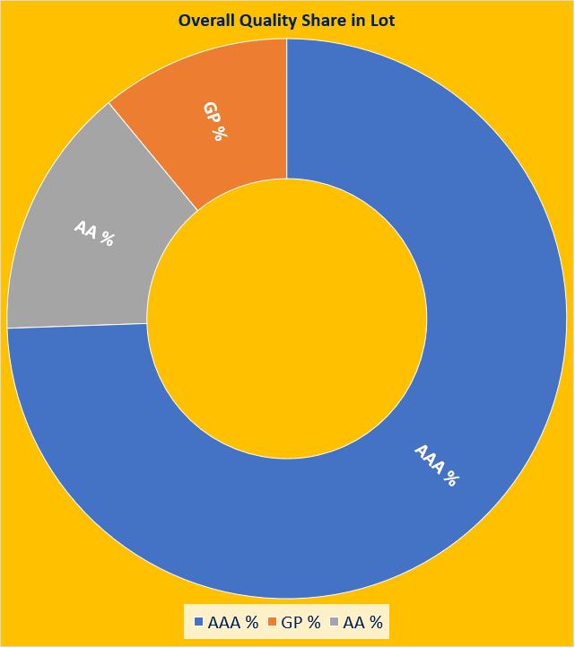
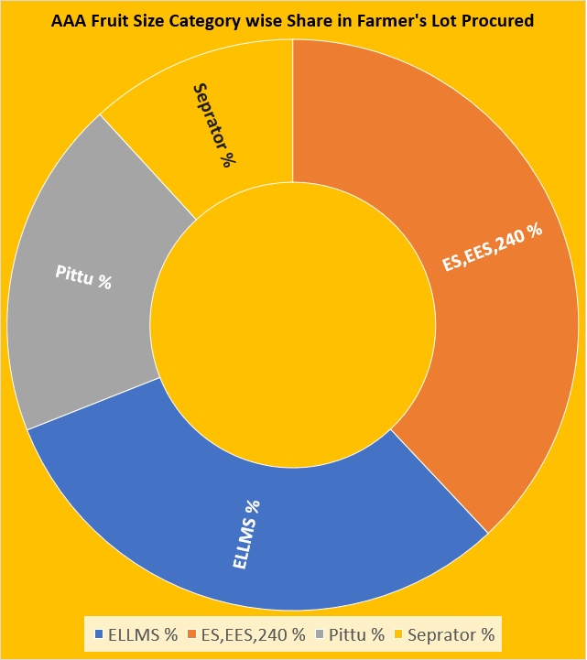

Slide 18
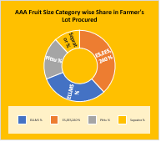
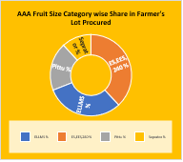
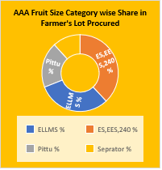
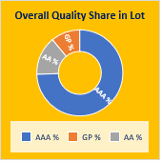
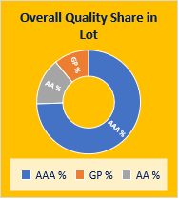

v
Commission Agent Live Screen
Farmer – Bidding Live Screen
v
Buyer’s Live Bidding Screen
Consignment No.
Commission Agents
Consignment No.
Gadd / Size
HP Police Personnel maintains a data entry vehicles. I will get the specific copy what they maintain which we will automate for them.
Consignment No.
Gadd / Size
Bae Price by CA
Base Price for Gadd Bidding
Base Price for LMS ,ES,EES, Pittu, Separator
Forward Bidding
Base Price
Live Bidding Price
UI-10 HP State Agriculture Produce Marketing Board
Add Buyers/Ladani for this Consignment
My Bid
HP State Agriculture Marketing Board Shimla
Traders
Ladani
Transporters
Pinjore
Chandigarh
Lucknow
Delhi
Forwarding Firms Pictures -
Bid Accepted Grower
Highest Bid Buyer
Commission Agents
Bid Closed
Highest Bid Accepted by Grower
Bid Closed by Commission Agent

